Slide 1
The Organized FSO Getting Control of the Paperwork and the Chaos
Presented by Dianne Walton
Facility Security Officer
Eagle 6 Technical Services, LLC
Fall FISWG/NCMS Training Event
October 18, 2017

Slide 2
From this……

Slide 3
To This

Slide 4
Disclaimers
This presentation is based on my personal organization strategy
This is not DSS directive or policy
These are suggestions based on NISPOM requirements and DSS guidance received over the years

Slide 5
5 Basic Principles of Organization
Purge the clutter
Less is more
A place for everything and everything in its place
Solid file structure
Group like items with like items
Keep things in logical groupings
Set up a system that works for you
If it don’t work for you…it don’t work
Use containers and labels
Properly labeled file folders

Slide 6
Organization is not “one Size Fits All”
The most important principle of organization…it’s not one size fits all – There's no one perfect system
Following the basic principles of organization you must develop a system that:
Fits your style
Conforms to NISPOM requirements
Conforms to your company policies
Fits with the size, structure, and status of your company

Slide 7
The Dianne Walton Way
During this presentation I will discuss some of the basic things I do to keep my work organized and to ensure I have all the documents and records required by DSS available for the SVA.
Please hold all questions for the end of the presentation.
At the end of the presentation I would some of you to share the organization strategies and techniques you use.

Slide 8
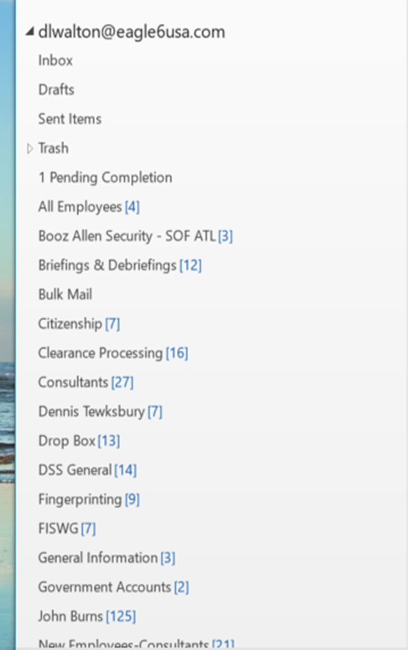
Organize you Email
Create .pst folders within your email program
Better organization
More efficient retrieval of emails
Help prevent lost emails
Pending folders
Pending Action
Pending Review
Pending Response

Slide 9
Organize email continued…
Create email templates for repeated use
Clearance granted
Processing for clearances
Monthly security bulletins, newsletters, etc.
Save the email template as “Outlook Message Format”
Include directions
Attachments – briefings, PowerPoint Presentations, etc.
Links to on-line training

Slide 10
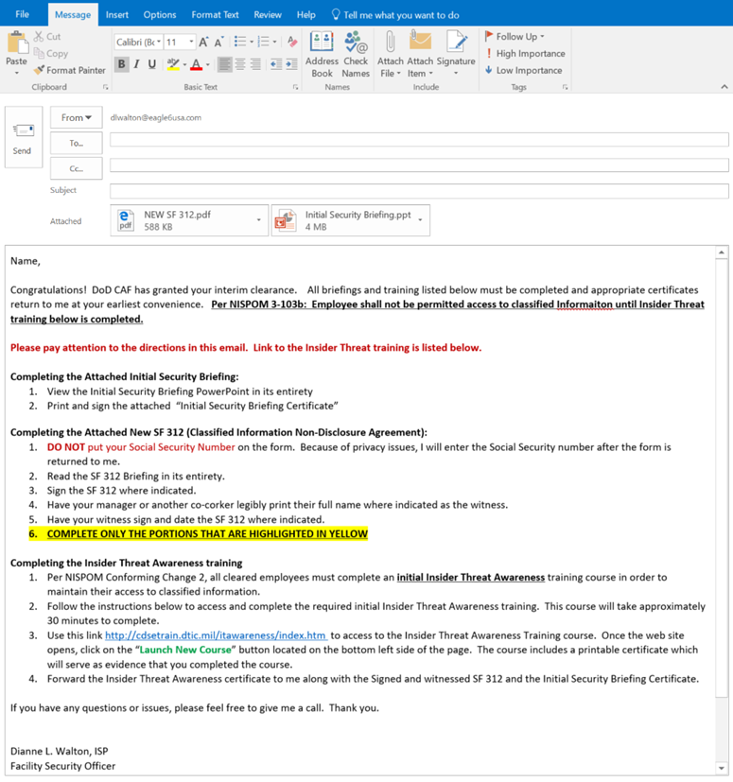
Organize email continued…
Email templates are customizable
Just add recepient
Copy manager
Enter name

Slide 11
Set Appointment and Reminder Notification in your Calendar
Reminders and Notifications in your Calendar
Yearly VALs that need to be sent
Annual briefings or training
Reminders to sign into government databases
JPAS training required annually
Set it and forget it! One less thing to try to remember and one less document or piece of paper!

Slide 12
Stacks of Paper
Attempt to keep stacks of paper to a minimum
When you must stack paper on your desk
Keep stacks organized
Must be completed today
Pending response or input from others
In process
Check sheets
Pending new hires, terminations

Slide 13
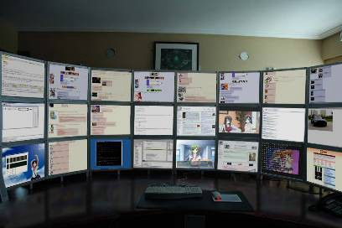
Monitors – More is Better
1st principle of organization: Less is more…
unless your talking about monitors!

Slide 14
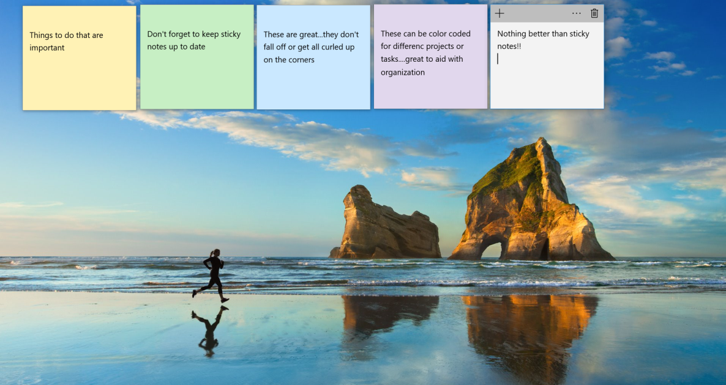
Desktop Sticky Notes What Can I say…Great Product
Old School
New School

Slide 15
Set a Schedule for your Day
First things first
Coffee
Email – Major form of communication/task assignment
Answer what you can to get it out of the way
Pending .pst folders
If you can’t avoid it – print it
Check calendar reminders for the day
Either leave reminder on the computer until complete or make a list. Leaving it on the computer means one less piece of paper that might get lost.
Check your paper stacks
Does anything need to be moved into the “must do today” stack

Slide 16
SVA Inspection Book
Although I keep all files in electronic format, I print out the documents I know my DSS Rep will want to see during the SVA and keep them in an SVA book
Keep book up-to-date by replacing or adding to
Keep update “List of Classified Contracts” provided by DSS prior to the SVA

Slide 17
SVA Inspection Book SVA Inspection Book File Tabs
Business Documents
Appointment Letters
Required Training
Consultants
Security Training
DD254 and contract list
Security Violations
Policies/Procedures
Self Inspections
NISP Enhancements

Slide 18
Check Sheets
Customized check sheets can help keep major multiple task processes organized
Prevent an associated Task from slipping through the cracks
Easy to reference sequential list of all tasks performed and date completed
Create for each multiple task process
Clearance investigation processing
New/incoming employees
Terminating employees

Slide 19
Check Sheets Cleared Employee In Processing

Slide 20
Check Sheets Cleared Employee Out Processing

Slide 21
Check Sheets Initial Investigation Initiation

Slide 22
Check Sheets Initial Investigation Initiation
Copies of these checklists will be made available to download on the FISWG site.
These are “form fill” documents, so they need to be used in the restrict editing mode.
When revising or editing the actual form remove editing restrictions.
When edit/revision is complete – Choose “Filling in forms” under editing restrictions and click on “yes, start enforcing protection”.
When asked for a password, simply click ok. The check sheets were saved with no password.

Slide 23
Security Folders
Hard copy or electronic
Electronic – backup to several devices weekly!
File to file copy – do not rely solely on automatic backup
Handouts
DSS suggested file folder headings
My personal file structure

Slide 24
Security Folders DSS Suggested File Folder Headings
This Suggested Contractor File Folder Headings job aid is available in the FSO Toolkit, on the FSO page, under the Best Practices heading at: http://www.cdse.edu/toolits/fsos/new-fso.html

Slide 25
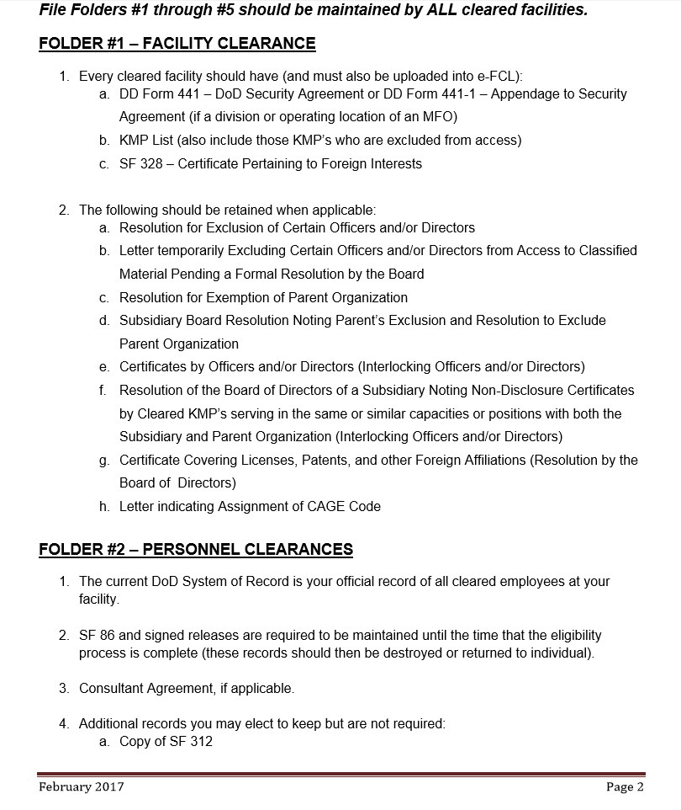
Security Folders DSS Suggested File Folder Headings

Slide 26
Security Folders DSS Suggested File Folder Headings

Slide 27
Security Folders DSS Suggested File Folder Headings

Slide 28
Security Folders DSS Suggested File Folder Headings

Slide 29
Security Folders DSS Suggested File Folder Headings

Slide 30
Security Folders DSS Suggested File Folder Headings

Slide 31
Security Folders DSS Suggested File Folder Headings

Slide 32
Security Folders My Personal File Structure
Note: This is a work in progress - under continuious revision

Slide 33
Security Folders My Personal File Structure

Slide 34
Security Folders My Personal File Structure

Slide 35
Security Folders My Personal File Structure

Slide 36
Security Folders My Personal File Structure

Slide 37
Security Folders My Personal File Structure

